Slide 1

The path to Bundle your Databricks projects
Fabian Gutierrez Ardts
SQLBits 2025

Slide 2







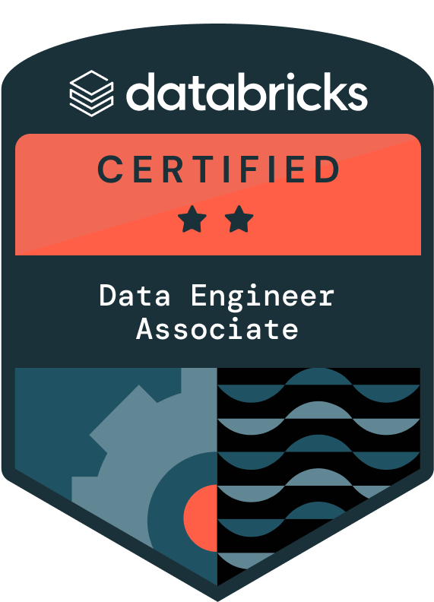


Fabian Gutierrez Ardts
Consultant | Azure & Databricks Data Engineer | Entrepreneur
20 years in the IT world, almost 15 years in Data world
Data Communities, Outdoor activities & travelling
linkedin.com/in/fabiangutierrezardts/
@FreeYourDataCon
github.com/FreeYourData
freeyourdata.nl

Slide 3

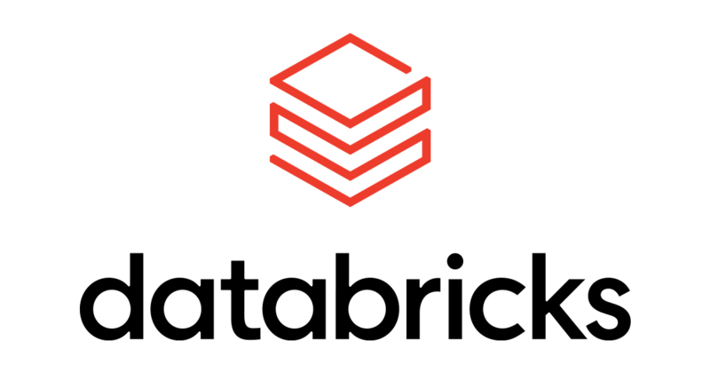
Why am I talking about Databricks Asset Bundles (DABS)?
Code handling and deployment mostly done with import/export of notebooks between DB (Databricks) workspaces.
Handling of DBR (Databricks Runtime) version and alignment between Clusters a highly manual and administrative work.
Many challenges on security level. The right code and data, for the right team, at the right workspaces and with the right permissions.
When DBAS announced to handle collaboration and automation, I was very eager to implement but encountered several challenges and learned many lessons.
Notes:
To mention at the end:
I look back and recognize there is a path to be followed, so let’s take a walk!

Slide 4
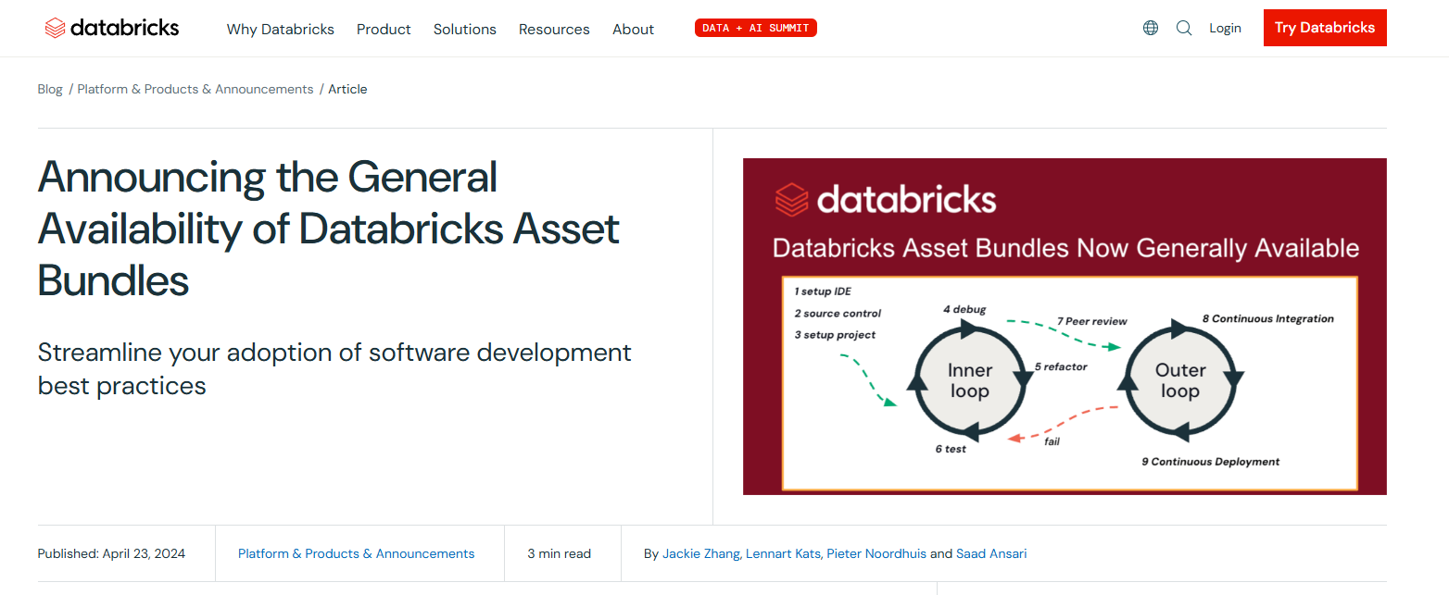
Where is DABS coming from?
Databricks strong adoption as Data and AI Platform within companies.
Due to its adoption the need for standardization in their CI/CD strategy, also referred to as Collaboration and Automation.
Became GA (general available) in April 2024

Slide 5
When to use it?
If we ask Databricks, we get:
Use them when you want to manage complex projects where multiple contributors and automation are essential, and continuous integration and deployment (CI/CD) are a requirement. Source: https://learn.microsoft.com/en-us/azure/databricks/dev-tools/bundles/
If you ask me, I’ll tell you:
With a team of 2+ members.
Several solutions running in Databricks or looking to migrate them.
Standardize deployment to your DTAP (Development, Test, Acceptance and Production) environments

Slide 6
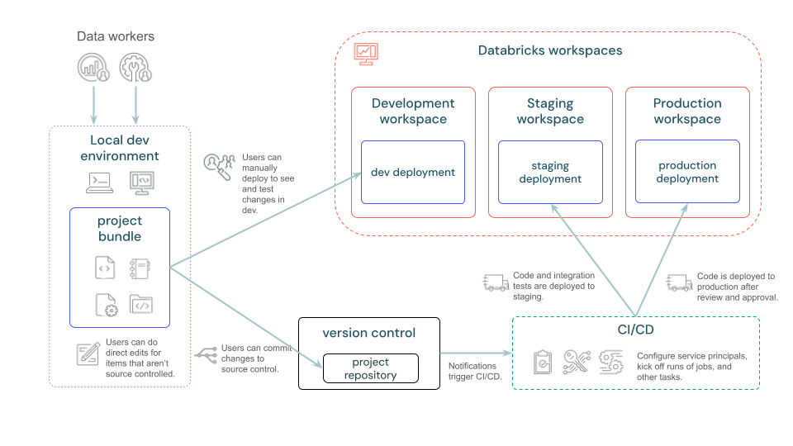
DABS Architecture

Slide 7
The path
Time to take a walk
Small Disclosure:
This is the path I would advise based on my own learning, lessons and experience.

Slide 8
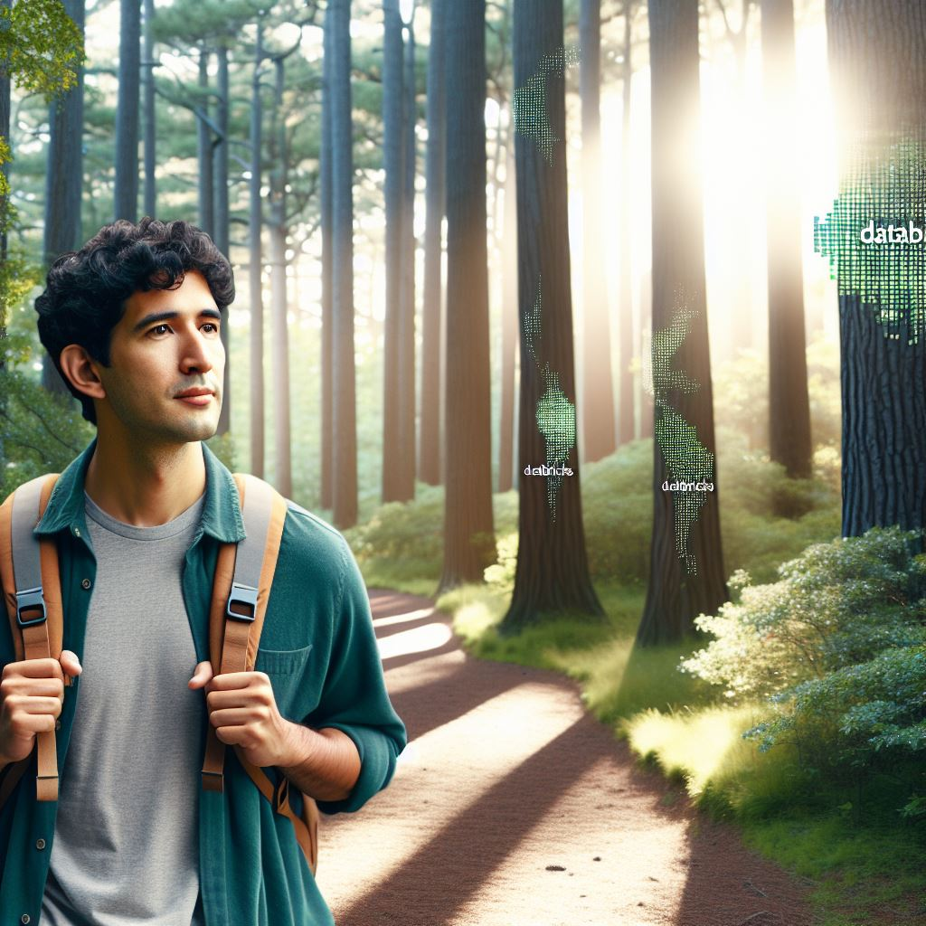
Imagine that you are walking a path for the first time.
What do you do?
You look for landmarks
“Things that tell you are on the right path”

Slide 9

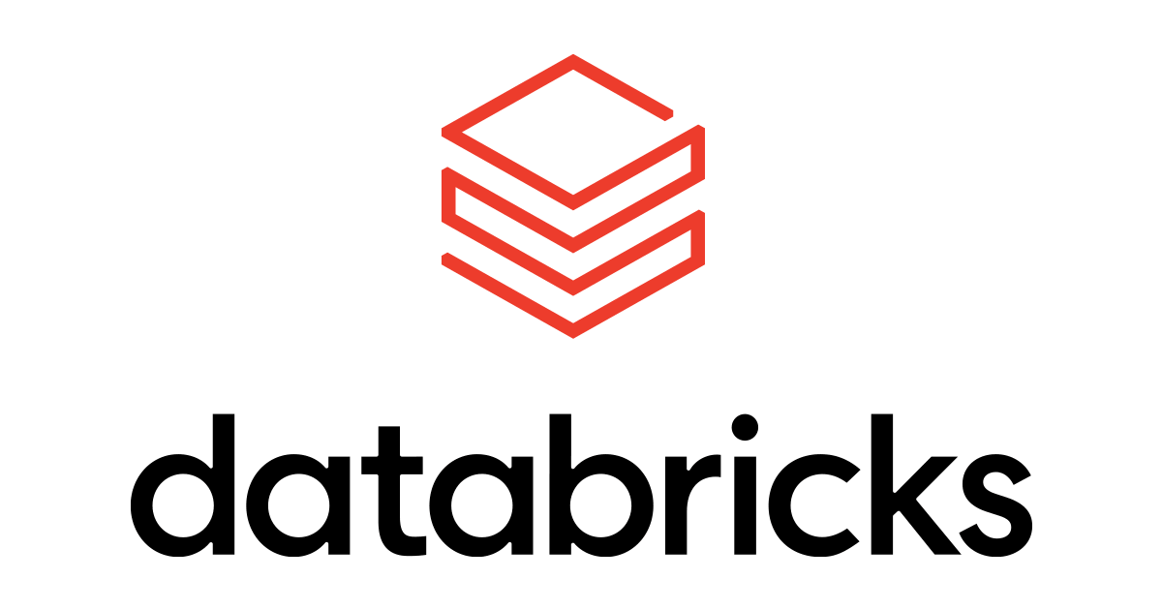


Landmarks to look for
Landscape
Resources
Projects

Slide 10



The landmarks
Landscape
Aspects that host and integrates your Databricks Data and AI environment.
Such as Development Environments, CI/CD, Databricks workspaces, Clusters, Network, Security and similar.
Anything that contributes within your Data & AI landscape.
This can be Development Tooling, External parties Libraries, Dependencies (technical and non-technical) , knowledge levels, Decision makers.
Resources
Projects
The core of what your Data& AI solution is delivering.
Such as Notebooks, Jobs, Pipelines, Models, Transformations, Dashboards and similar.

Slide 11
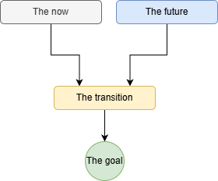
The path
Notes:
Explain: The transition is for existing situation making a move to The Future.

Slide 12
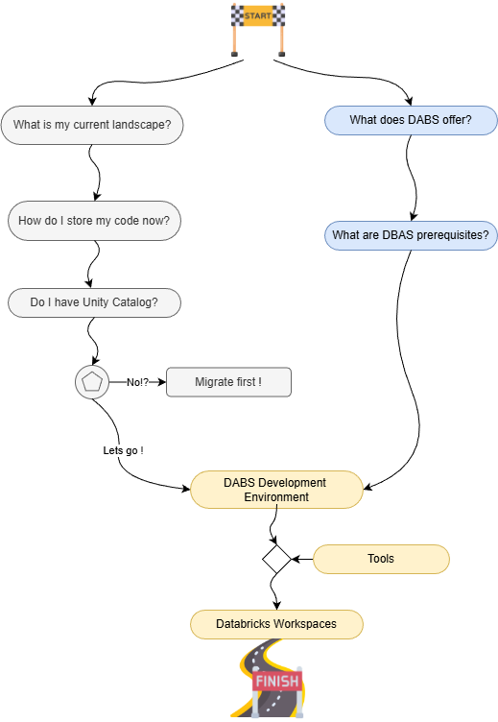
The path

Slide 13


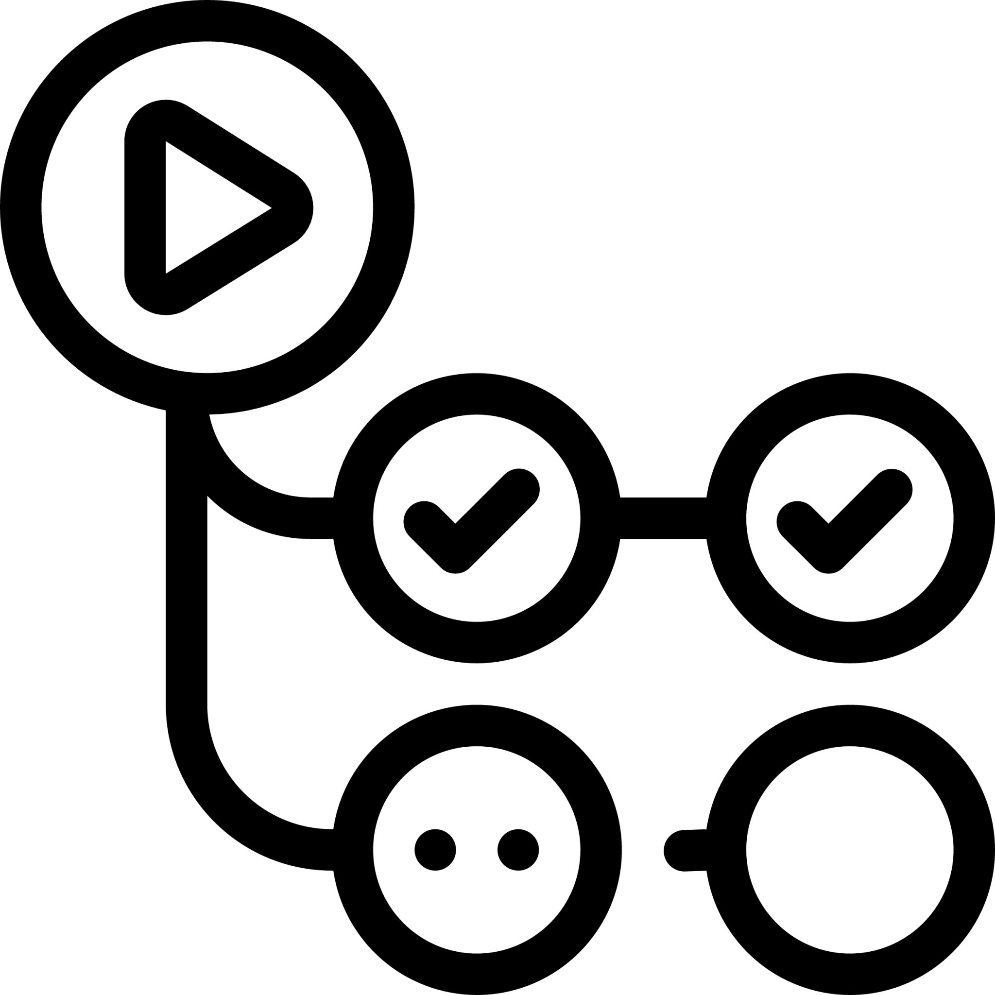



What is my current Landscape?
Security:
Access: Where in your Databricks workspaces?
Who ? Such as Users and Service Accounts.
Authentication methods: Used, example PAT (Personal Access Token)
DevOps:
CI/CD landscape
Build agents: (un)managed & capabalities
OnPremise/Cloud
Network:
Internal, Public, Subnets, Firewall
Shared/Peripheral resources
Decision Makers:
Architects, Managers / Product Owners, Stakeholders
If not directly involved, at least to be informed
Teams:
Knowledge level
Current WoW (Way-of-working)
Responsabilities

Slide 14
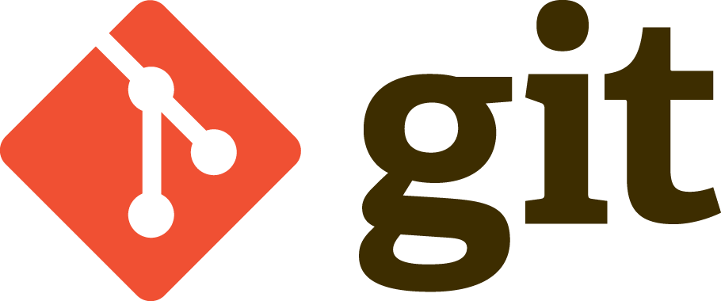
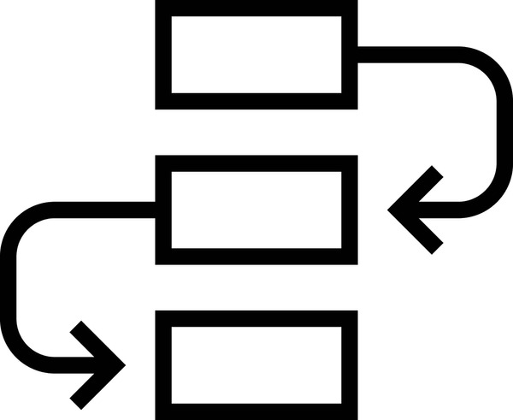
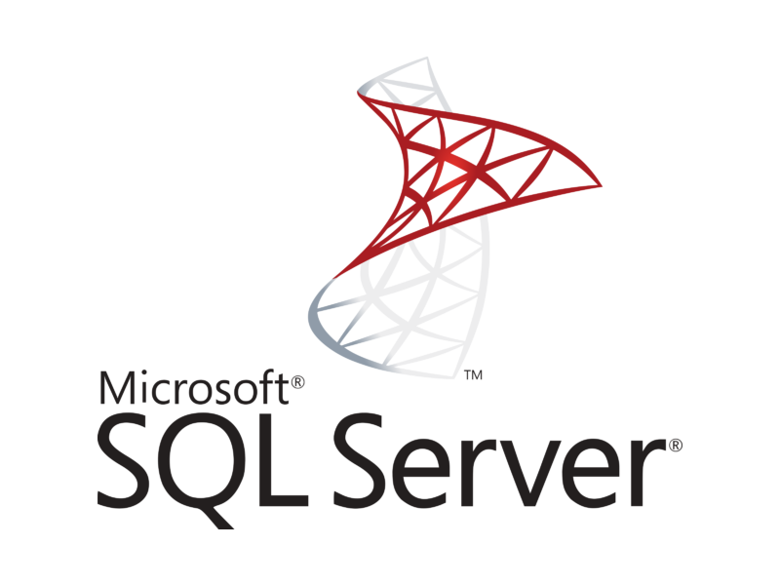
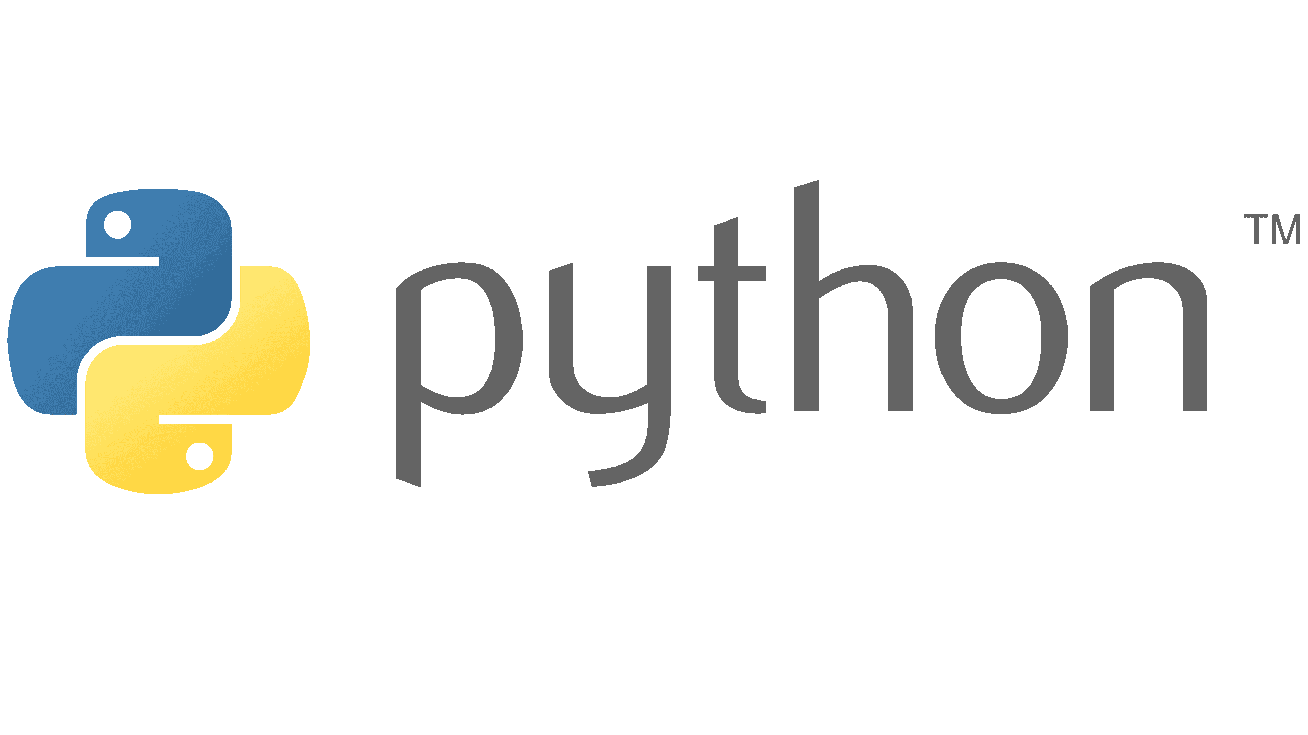



How do I store my code now?
Storage:
Repositories: Git, GitHub, OneDrive, SharePoint, other.
Source code: Flat files, Jupyther notebooks, .PS1, .py, .r, .scala, .sql
Data: Storage Account, S3, Azure ML, SQL Server, sFTP, others.
Dependencies:
Libraries, Packages, Test Frameworks
Compilers and Languages:
t-SQL,
Python,
Spark,
Scala,
R,
SparkSQL,
C#,
Bash,
CLI,
PowerShell,
others…

Slide 15
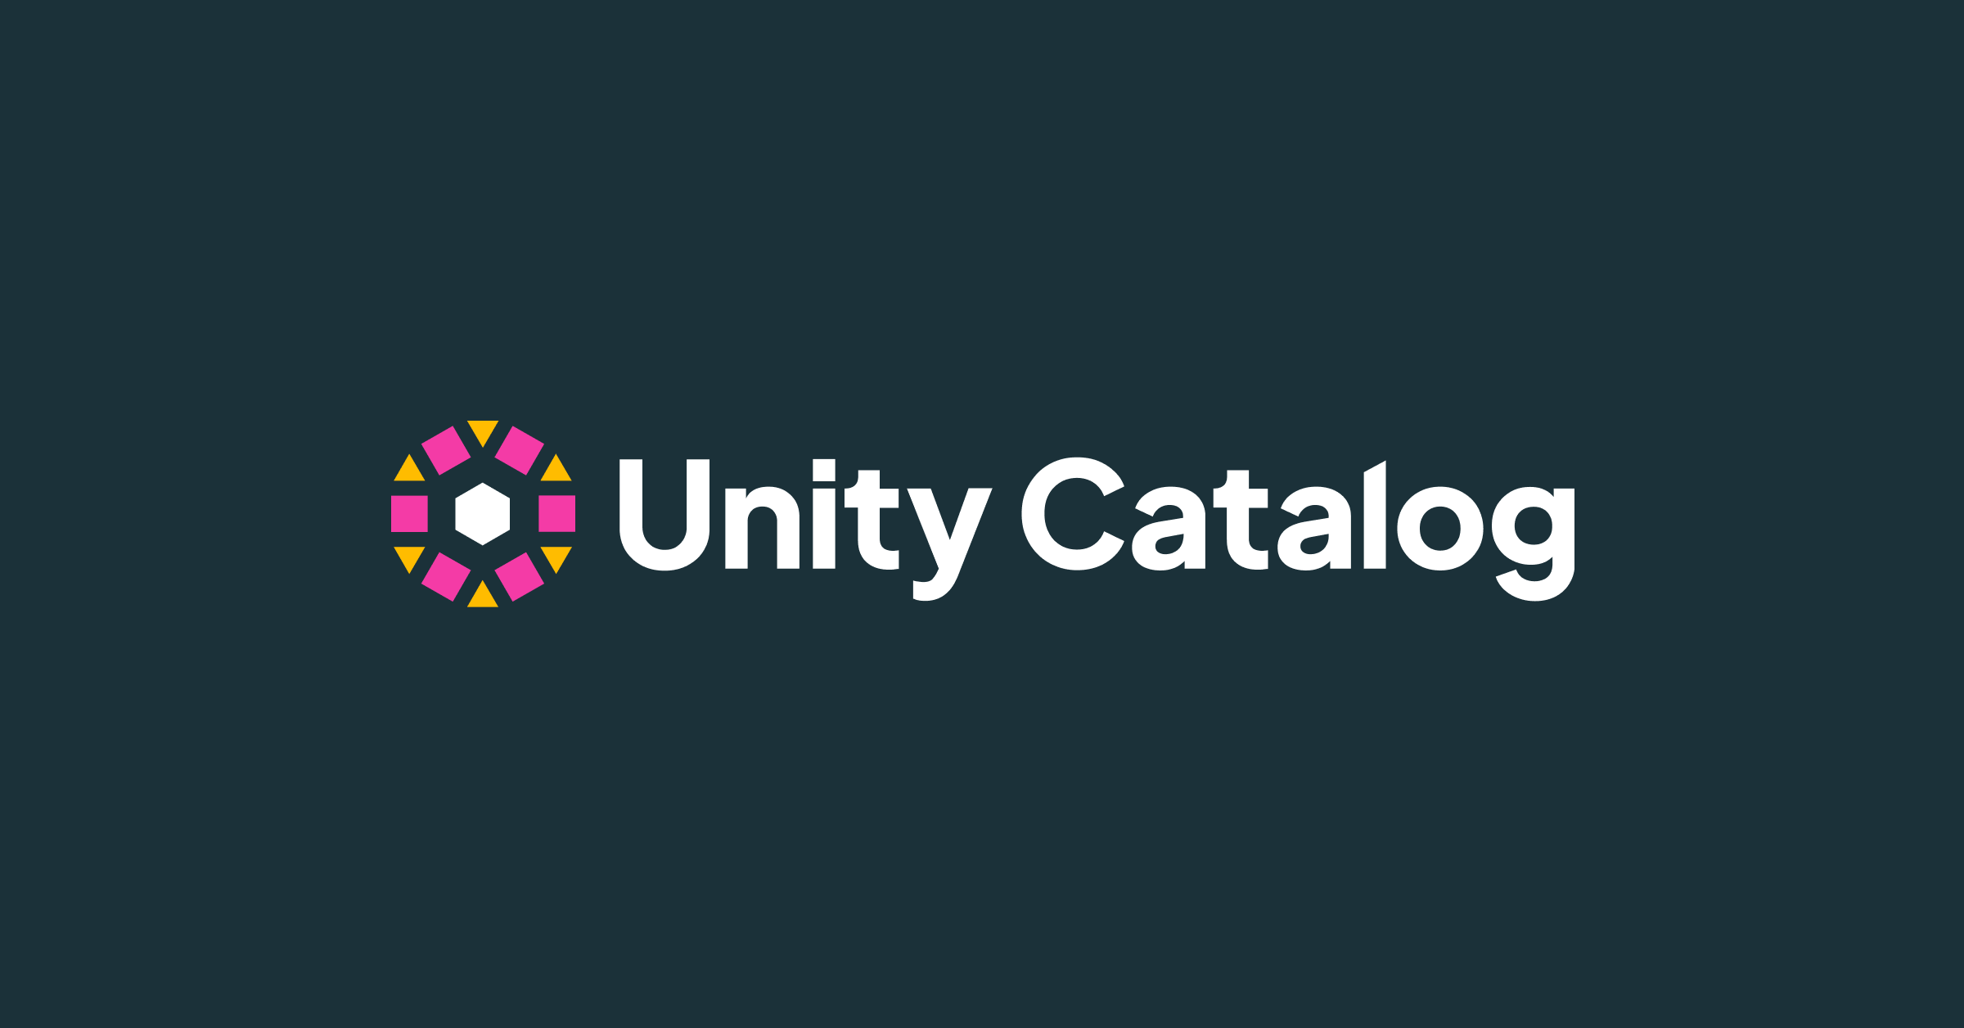
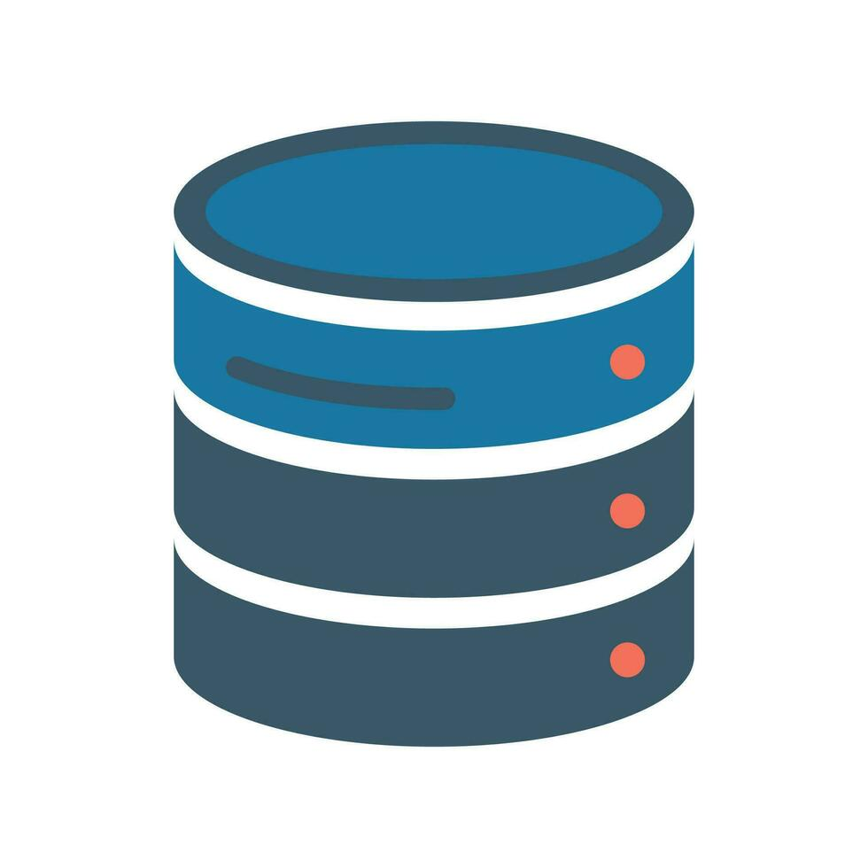
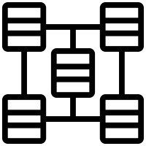


Do I have Unity Catalog ?
By enabling or moving to Unity Catalog you will benefit from:
Shared Data:
Volumes (external locations for Data points),
Data sets across workspaces,
Data Catalogs and more.
Shared Clusters:
Libraries
Init scripts
Access Mode: Shared or Single User
Scala workloads (DBR v13.3 LTS or later)
From individual to shared and governed:
UDF (User Defined Functions) for Python and Pandas
Machine Learning and Structured Streaming
Governance, Lineage and Security

Slide 16

Demo time
Let me check my gear

Slide 17

What does DABS offer?
Configuration:
Cloud Infrastructure
Workspace(s)
Source files
Notebooks
Jupyther (.ipynb)
Python (.py)
Scala (.scala)
R (.r)
SQL (.sql)
Configuration
YAML (.yml)
Project templates or custom

Slide 18
What does DABS offer?
Definitions & Settings:
Jobs
DLT (Delta Live Tables)
Model Serving Endpoint
ML Flow Experiments
Registered Models
Unit & Integration Testing
(OOP) Objects
Python
R
Scala
SQL

Slide 19
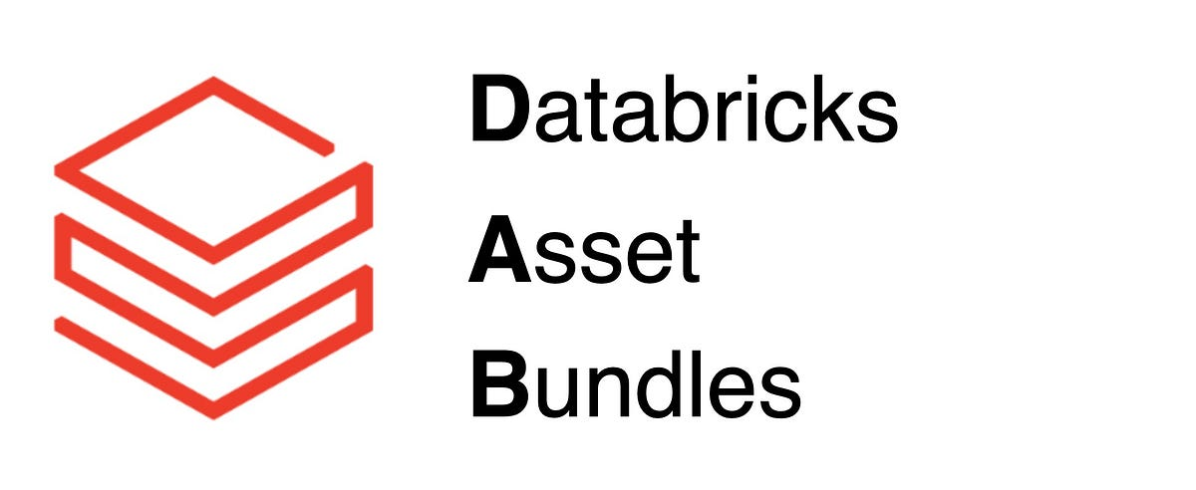

What are DABS prerequisites?
Storage:
Source code version repositories (Az DevOps Git, GitHub, Bitbucket, GitLab, AWS CodeCommit)
DevOps: CI/CD Strategy covering DTAP environments and their purposes.
Network: Internal or Public access to DB Workspaces
Subnets
Decision Makers:
Architects, P.O./Managers, Stakeholders, Team DBAS developers.
Configuration (YAML):
Clusters: Agree beforehand which ones and their properties
Dashboards
Experiments
Jobs
Models
Pipelines
Schemas
Volumes

Slide 20
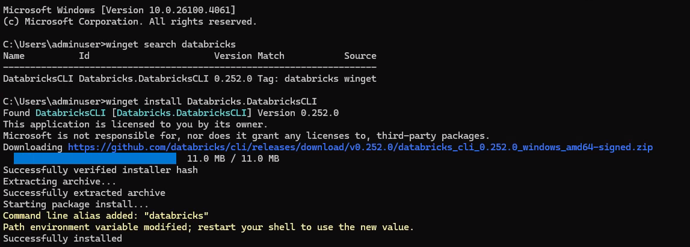

What are DABS prerequisites?
Databricks CLI version on Clients
Databricks Connect for local development and debugging. Is a client library for the Databricks Runtime that allows you to connect popular IDEs to Databricks compute.
Clients depends on Python version when working on Python projects.
Dependency with DBR versions.
Configuration file
Covers Authentication and DTAP environments among the team
Required for CI/CD strategy

Slide 21

Demo time
Lets walk !

Slide 22


What are DABS prerequisites?
Deployment: The magic behind the curtain
DABS uses TF (Terraform) to package and deploy the different objects to the DB Workspaces.
Terraform is an open-source Infrastructure as Code (IaC) tool created by HashiCorp. It allows users to define and provision infrastructure using a declarative configuration language. Terraform enables developers to create, update, and manage infrastructure components

Slide 23
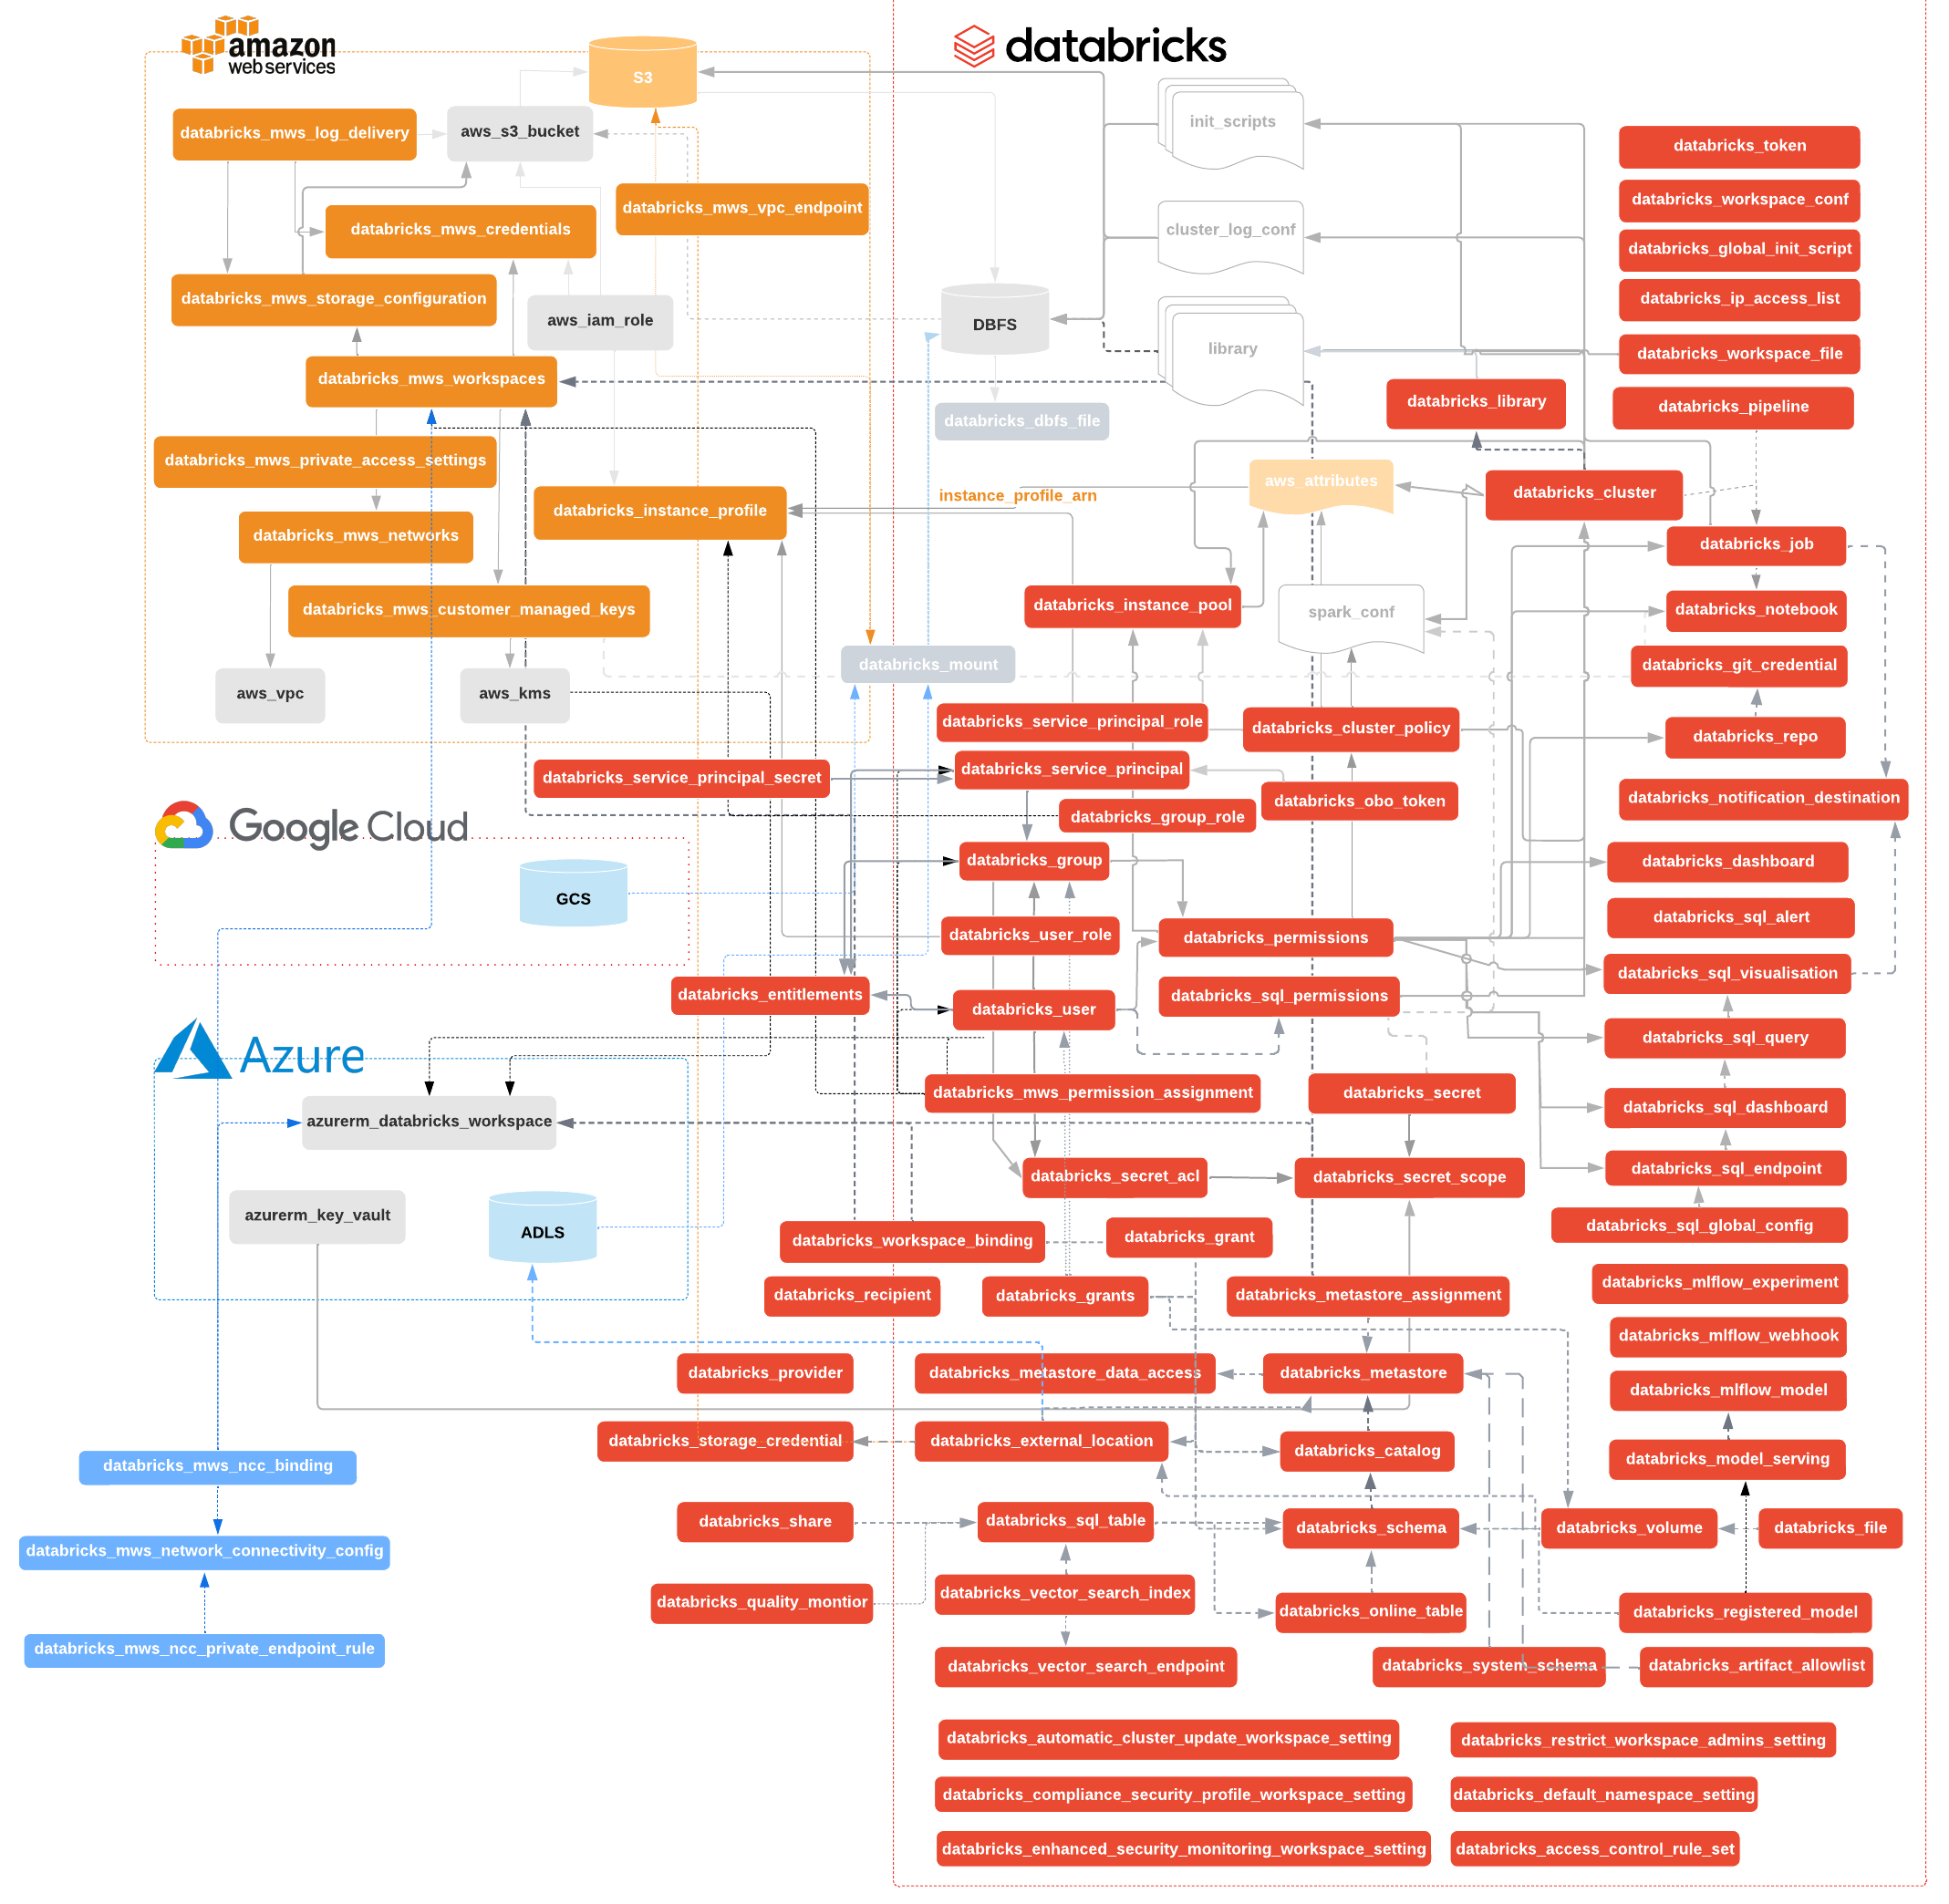

Databricks Terraform provider
What are DABS prerequisites?
https://github.com/databricks/terraform-provider-databricks/blob/main/README.md
Don’t be scared if the first thing you see in the ReadMe file is this image

Slide 24
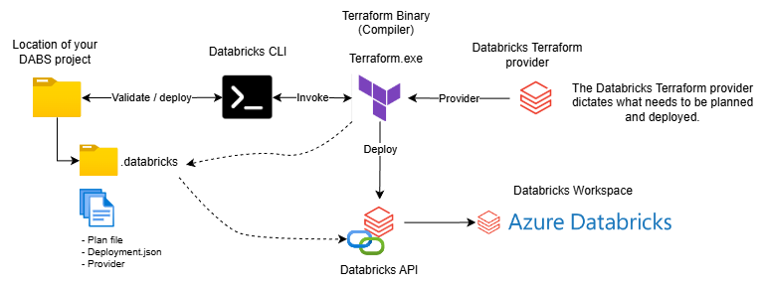

TF Deployment strategy
What are DABS prerequisites?
Terraform Binary
Warning! NO Windows ARMx64 TF Binary supported.
Terraform provider Databricks
Works with Terraform 1.1.5 or newer.
Both are obtained (downloaded) online when validating and deploying.

Slide 25

Show time
Let us invite more people to walk with us

Slide 26
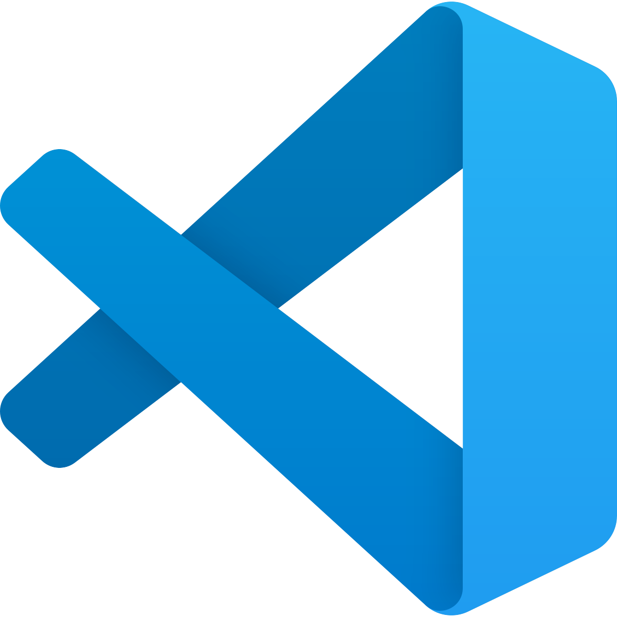


DABS Development environment
Azure DevOps / GitHub
Pipelines
Build agents
Service connections
If network is isolated
Go then for ‘air gapped’ approach
Download Databricks CLI Docker image
Offline download together local variables
Wait until dependency are removed (long term)
Databricks Clusters
Align DB Connect version with clusters
Policies:
Shared
Single-Use
Serverless
Databricks Connect

Slide 27

DABS Development environment
DBAS Developer mindset and knowledge
Local debugging, no longer via Databricks IDE.
Faster Time-to-Prod.
Adopt Unit and Integration testing.
Agree / Align on folder structure
Authentication
Configuration File containing Authentication method.
Avoid using PAT ! and use OAuth U2M (User-to-machine) or M2M (Machine-to-Machine)
Place config file in your source code to be shared.

Slide 28


Tools
VS Code
Databricks Extension
Includes:
Databricks Connect
For Python
For R
For Scala
Remember !
Align with the DABS development team on the versions to be used.
Databricks CLI
Python compiler

Slide 29

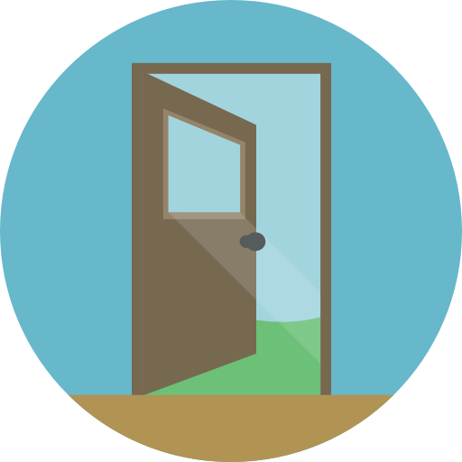
Databricks Workspaces
Workspaces
Premium pricing tier (+ Role Based Access Control)
at least for ACC and PRD.
Link DEV to Git Provider
Project(s) Folder location
For DEV use
/Workspace/{user}/.bundle/ {bundle name} in a Git folder
Access
Use Unity Catalog Lakehouse Federation
Use Entra Security Groups attached to DB groups
Link Permissions to Groups
Enable ACL (Access Control List) feature.
Such as Clusters, Tables, Volumes, etc.
In case of Shared resource use /Workspace/Shared/{bundle name}
For TST, ACC & PRD use /Workspace/projects/{bundle name}

Slide 30
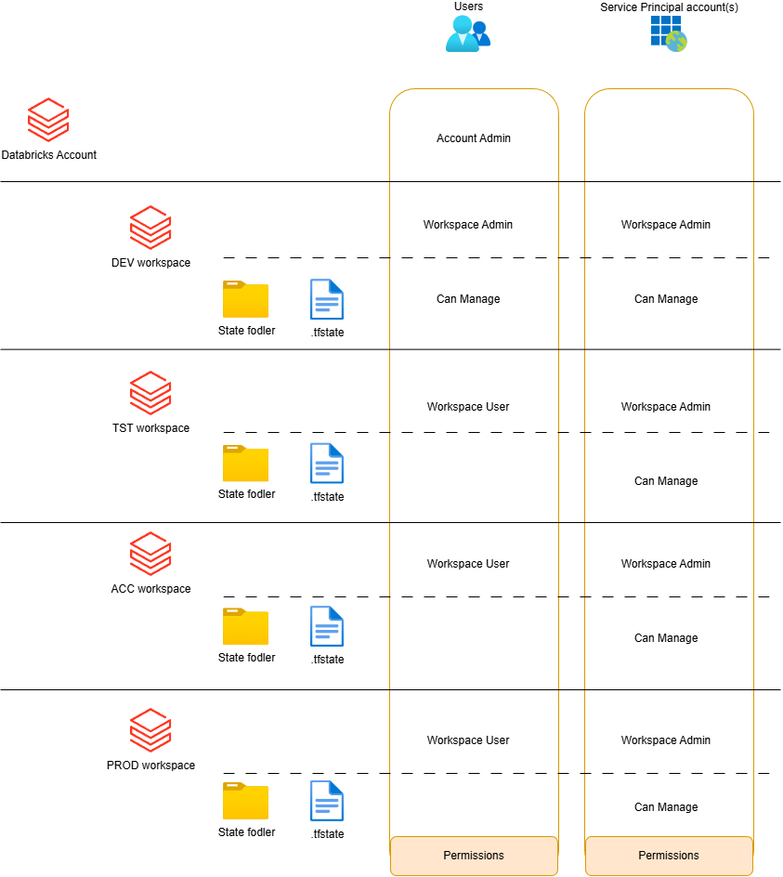
Approach to secure your TF State file
Databricks Workspaces
Keep your CISO happy
Isolate folder for your TF State file.

Slide 31

Show time
Let us all walk together

Slide 32
Wrap up
Hope no blisters from walking

Slide 33
Wrap up
DABS covers deployment of most if not all of your current or future resources.
Understand what's involved by comparing your landscape with DABS features.
Work first on highlighting the gaps.
Ensure the team mindset, skill sets and environments are aligned with your DABS strategy.
Recognize what are really your projects.
Define a folder structure within your Workspace considering access, projects and dependencies.
Notes:
Work first on highlighting the gaps: explain what I mean between the now and future.
Recognize what are your projects: use example of different teams with the same workspace.

Slide 34

References
Databricks Asset Bundle
https://github.com/databricks/databricks-asset-bundles-dais2023
https://learn.microsoft.com/en-us/azure/databricks/dev-tools/bundles/
https://learn.microsoft.com/en-us/azure/databricks/dev-tools/bundles/variables
Databricks Connect
What is Databricks Connect? - Azure Databricks | Microsoft Learn
https://docs.databricks.com/aws/en/dev-tools/databricks-connect/
Databricks GitHub
https://github.com/databricks

Slide 35

Thank you!
Stay in contact
linkedin.com/in/fabiangutierrezardts/
@FreeYourDataCon
github.com/FreeYourData
fabian.gutierrez@freeyourdata.nl

Slide 36

Please give your feedback via SQL Bits App
Stay in contact
linkedin.com/in/fabiangutierrezardts/
@FreeYourDataCon
github.com/FreeYourData
fabian.gutierrez@freeyourdata.nl

